Slide 1
Electronics Systems (938II)
Lecture 3.3
Semiconductor Memories – EPROM and EEPROM

Slide 2
Brief recall*
Evolution of Read-Only Memories (ROMs)
Mask-ROM

Slide 3
Brief recall*
Evolution of Read-Only Memories (ROMs)
Mask-ROM
PROM

Slide 4
Brief recall*
Evolution of Read-Only Memories (ROMs)
Mask-ROM
PROM
Programmed after manufacturing

Slide 5
Brief recall*
Evolution of Read-Only Memories (ROMs)
Mask-ROM
PROM
Programmed during manufacturing
Programmed after manufacturing

Slide 6
What after?*
Evolution of Read-Only Memories (ROMs)
Mask-ROM
PROM
Programmed during manufacturing
Programmed after manufacturing

Slide 7
EPROM*
Evolution of Read-Only Memories (ROMs)
After PROM: Erasable PROM (EPROM)
Mask-ROM
PROM
Programmed during manufacturing
Programmed after manufacturing

Slide 8
EPROM*
Programmed after manufacturing
Evolution of Read-Only Memories (ROMs)
After PROM: Erasable PROM (EPROM)
Mask-ROM
PROM
EPROM
Programmed during manufacturing
Programmed after manufacturing

Slide 9
EPROM*
Programmed after manufacturing
Evolution of Read-Only Memories (ROMs)
After PROM: EPROM
Mask-ROM
PROM
EPROM
UV-EPROM
EEPROM

Slide 10
EPROM*
Programmed after manufacturing
Evolution of Read-Only Memories (ROMs)
After PROM: EPROM
Mask-ROM
PROM
EPROM
UV-EPROM
EEPROM
Erased by optical
process (UV rays)

Slide 11
EPROM*
Programmed after manufacturing
Evolution of Read-Only Memories (ROMs)
After PROM: EPROM
Mask-ROM
PROM
EPROM
UV-EPROM
EEPROM
Erased by optical
process (UV rays)
Erased by electrical process

Slide 12
EPROM*
Generally speaking
It is a ROM
Run-time working principle similar to the that of mask-ROM/PROM
That can be programmed
And erased
So reprogrammed !!!

Slide 13
EPROM – Underlying Technology*
It relies on particular MOS transistors

Slide 14
EPROM – Underlying Technology*
It relies on particular MOS transistors
FGMOS = Floating Gate MOS
In practice, a MOS + one additional (floating) gate

Slide 15
EPROM – Underlying Technology*
It relies on particular MOS transistors
FGMOS
In practice, a MOS + one additional (floating) gate
Traditional MOS transistor
G = (control) Gate
S = Source
D = Drain

Slide 16
EPROM – Underlying Technology*
It relies on particular MOS transistors
FGMOS
In practice, a MOS + one additional (floating) gate
Traditional MOS transistor
Metal
G
S
D

Slide 17
EPROM – Underlying Technology*
It relies on particular MOS transistors
FGMOS
In practice, a MOS + one additional (floating) gate
Traditional MOS transistor
Metal
Oxide
G
S
D

Slide 18
EPROM – Underlying Technology*
It relies on particular MOS transistors
FGMOS
In practice, a MOS + one additional (floating) gate
Traditional MOS transistor
Metal
Oxide
Silicon
G
S
D

Slide 19


EPROM – Underlying Technology*
It relies on particular MOS transistors
FGMOS
In practice, a MOS + one additional (floating) gate
Traditional MOS transistor
Metal
Oxide
Silicon
G
S
D

Slide 20

EPROM – Underlying Technology*
It relies on particular MOS transistors
FGMOS
In practice, a MOS + one additional (floating) gate
G
Floating Gate
S
D

Slide 21
EPROM – Underlying Technology*
It relies on particular MOS transistors
FGMOS
In practice, a MOS + one additional (floating) gate
Floating gate = empty (default)
It behaves like a “traditional” MOS
G
Floating Gate
S
D

Slide 22


EPROM – Underlying Technology*
It relies on particular MOS transistors
FGMOS
In practice, a MOS + one additional (floating) gate
Floating gate = full of electrons (programmed)
It behaves like a “traditional” MOS
But with a higher $V_{T}$ → $V_{T}^{′}$
G
Floating Gate
S
D

Slide 23


EPROM – Underlying Technology*
It relies on particular MOS transistors
FGMOS
In practice, a MOS + one additional (floating) gate
Using a reading voltage ($V_{R}$) on the gate ($V_{GS}=V_{R}$), such that $V_{T}<V_{R}<V_{T}^{′}$
G
Floating Gate
S
D

Slide 24

EPROM – Underlying Technology*
It relies on particular MOS transistors
FGMOS
In practice, a MOS + one additional (floating) gate
Using a reading voltage ($V_{R}$) on the gate ($V_{GS}=V_{R}$), such that $V_{T}<V_{R}<V_{T}^{′}$
Transistor = ON, if not programmed ($V_{T}$)
Short circuit: D = S
G
Floating Gate
S
D
ON

Slide 25

EPROM – Underlying Technology*
It relies on particular MOS transistors
FGMOS
In practice, a MOS + one additional (floating) gate
Using a reading voltage ($V_{R}$) on the gate ($V_{GS}=V_{R}$), such that $V_{T}<V_{R}<V_{T}^{′}$
Transistor = OFF, if programmed ($V_{T}^{′}$)
Open circuit: D disconnected from S
G
Floating Gate
S
D
ON
OFF

Slide 26
EPROM – Underlying Technology*
Applying FGMOS to semiconductor memories architecture …
FGMOS symbol
D
G
S

Slide 27


EPROM – Underlying Technology*
Applying FGMOS to semiconductor memories architecture …
FGMOS symbol
D
G
S

Slide 28


EPROM – Underlying Technology*
Applying FGMOS to semiconductor memories architecture …
FGMOS symbol
D
G
$$WL_{i}$$
S
$$BL_{j}$$

Slide 29

EPROM – Underlying Technology*
Applying FGMOS to semiconductor memories architecture …
Working principle
FGMOS not programmed
Reading with $V_{R}>V_{T}$ on $WL_{i}$
FGMOS = ON
FGMOS = short circuit → $D=S$ → $V_{D}=V_{S}$
$BL_{j}=0$ (logic) ${=V}_{D}$
$$WL_{i}$$
$$BL_{j}$$

Slide 30

EPROM – Underlying Technology*
Applying FGMOS to semiconductor memories architecture …
Working principle
FGMOS programmed
Reading with $V_{R}<V_{T}^{′}$ on $WL_{i}$
FGMOS = OFF
FGMOS = open circuit → $D≠S$ → $V_{D}≠V_{S}$
$BL_{j}=1$ (logic) from pull-up resistor (R)
$$WL_{i}$$
$$BL_{j}$$

Slide 31
EPROM – Underlying Technology*
Applying FGMOS to semiconductor memories architecture …
Why does this work?
Because of …
Time required for programming/erasing
Data retention
Endurance
$$WL_{i}$$
$$BL_{j}$$

Slide 32
EPROM – Underlying Technology*
Applying FGMOS to semiconductor memories architecture …
Why does this work?
Because of …
Time required for programming/erasing
Programming = injection of electrons into the floating gate
Erasing = removal of electrons from the floating gate
Erasing + programming (cycle) takes a time in the order of minutes
$$WL_{i}$$
$$BL_{j}$$

Slide 33

EPROM – Underlying Technology*
Applying FGMOS to semiconductor memories architecture …
Why does this work?
Because of …
Data retention
Permanence time of electrons in the floating gate (once injected) $≈10÷20$ years
Greater than duration of typical electronic application
$$WL_{i}$$
$$BL_{j}$$

Slide 34

EPROM – Underlying Technology*
Applying FGMOS to semiconductor memories architecture …
Why does this work?
Because of …
Endurance
Number of cycles (erasing + programming) = endurance
Endurance is limited
Moving electrons through the oxide degrades it
However, it is not low: typically, in the range ${10}^{3}÷{10}^{5}$
$$WL_{i}$$
$$BL_{j}$$

Slide 35
EPROM – Underlying Technology*
Two different kinds of FGMOS
Changing the way electrons are injected into (programming) and removed from (erasing) floating gate
FAMOS = Floating-gate Avalanche-injection MOS
FLOTOX = Floating-gate Tunnel-Oxide MOS

Slide 36
FAMOS transistor*
Same layout and symbol as FGMOS
It was the first FGMOS
G
Floating Gate
D
G
S
D
S

Slide 37


FAMOS transistor*
Working principle
Electrons injection (programming)
Avalanche effect = very high current → Floating-gate Avalanche-injection MOS
$V_{G}=V_{D}=V_{PP}$ (programming voltage, $V_{PP}≫V_{R}$)
$V_{S}=0$
G
G
S
D
S
D

Slide 38
FAMOS transistor*
Working principle
Electrons removal (erasing)
Exposure to UV light
G
G
S
D
S
D

Slide 39
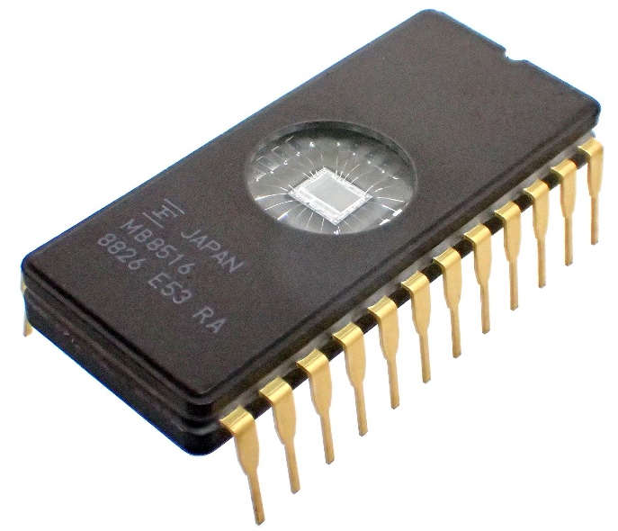
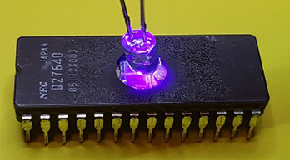
UV-EPROM (or EPROM)*
It is based on FAMOS transistor
In practice, it is a PROM with FAMOS transistor instead of MOS + fuse (or anti-fuse)
Erasing procedure = exposure to UV light
From here the name → UV-EPROM
The chip is encapsulated in a window
Erasing the whole chip (ROM content) at once
Also called just EPROM
It was the first type of EPROM

Slide 40









UV-EPROM (or EPROM)*
Working principle
Reading: the same as ROM/PROM
If transistor programmed → OFF
Otherwise (not programmed) → ON
Erasing: exposure to UV light
Programming – Example
Programming cell (1,1)
$$BL_{0}$$
$$BL_{1}$$
$$BL_{2}$$
$$WL_{0}$$
$$WL_{1}$$

Slide 41

UV-EPROM (or EPROM)*
Working principle
Reading: the same as ROM/PROM
If transistor programmed → OFF
Otherwise (not programmed) → ON
Erasing: exposure to UV light
Programming – Example
Programming cell (1,1)
$V_{G}=WL_{1}=V_{PP}$
$V_{D}=BL_{1}=V_{PP}$
$$BL_{0}$$
$$BL_{1}$$
$$BL_{2}$$
$$WL_{0}$$
$$WL_{1}$$

Slide 42

UV-EPROM (or EPROM)*
Working principle
Reading: the same as ROM/PROM
If transistor programmed → OFF
Otherwise (not programmed) → ON
Erasing: exposure to UV light
Programming – Example
Programming cell (1,1)
$V_{G}=WL_{1}=V_{PP}$
$V_{D}=BL_{1}=V_{PP}$
All other $WL_{i}=0$ and $BL_{j}=0$!
$$BL_{0}$$
$$BL_{1}$$
$$BL_{2}$$
$$WL_{0}$$
$$WL_{1}$$

Slide 43
FLOTOX transistor*
Some differences w.r.t. FAMOS transistor
Floating gate extends over Drain and is separated from it by a very thin oxide layer

Slide 44

FLOTOX transistor*
Some differences w.r.t. FAMOS transistor
Floating gate extends over Drain and is separated from it by a very thin oxide layer
G
Floating Gate
G
Floating Gate
D
S
D
FAMOS
FLOTOX

Slide 45
FLOTOX transistor*
Some differences w.r.t. FAMOS transistor
Also the symbol is different
G
Floating Gate
D
G
S
D
S

Slide 46

FLOTOX transistor*
Working principle
Electrons injection (programming)
Tunnel effect (thanks to the very thin oxide layer) → Floating-gate Tunnel-Oxide MOS
$V_{G}=V_{PP}$
$V_{D}=0$
$V_{S}$: not specified
G
G
S
D
S
D

Slide 47

FLOTOX transistor*
Working principle
Electrons removal (erasing)
Tunnel effect (again)
$V_{G}=0$
$V_{D}=V_{PP}$
$V_{S}$: not specified
G
G
G
S
D
S
D

Slide 48
EEPROM (or E²PROM)*
It is based on FLOTOX transistor
In practice, it is a PROM with FLOTOX transistor instead of MOS + fuse (or anti-fuse)
Ideally !!!
Erasing procedure = tunnel effect due to electrical quantities
From here the name → EEPROM = Electrically Erasable PROM
Or E²PROM
Erasing only selected memory cells (FLOTOX transistors)

Slide 49

EEPROM (or E²PROM)*
It is based on FLOTOX transistor
In practice, it is a PROM with FLOTOX transistor instead of MOS + fuse (or anti-fuse)
Ideally !!!
Erasing procedure = tunnel effect due to electrical quantities
From here the name → EEPROM = Electrically Erasable PROM
Or E²PROM
Erasing only selected memory cells (FLOTOX transistors)

Slide 50


EEPROM (or E²PROM)*
Architecture (ideal)
$$BL_{0}$$
$$BL_{1}$$
$$BL_{2}$$
$$WL_{0}$$
$$WL_{i}$$
$$WL_{1}$$
$$BL_{j}$$

Slide 51





EEPROM (or E²PROM)*
Architecture (ideal)
Programming cell (0,1)
$$BL_{0}$$
$$BL_{1}$$
$$BL_{2}$$
$$WL_{0}$$
$$WL_{1}$$

Slide 52

EEPROM (or E²PROM)*
Architecture (ideal)
Programming cell (0,1)
$V_{G}=WL_{0}=V_{PP}$
$V_{D}=BL_{1}=0$
$$BL_{0}$$
$$BL_{1}$$
$$BL_{2}$$
$$WL_{0}$$
$$WL_{1}$$

Slide 53



EEPROM (or E²PROM)*
Architecture (ideal)
Programming cell (0,1)
$V_{G}=WL_{0}=V_{PP}$
$V_{D}=BL_{1}=0$
All other $BL_{j}=V_{PP}$
Otherwise the other cells in the same $WL_{0}$ are programmed !
$$BL_{0}$$
$$BL_{1}$$
$$BL_{2}$$
$$WL_{0}$$
$$WL_{1}$$

Slide 54


EEPROM (or E²PROM)*
Architecture (ideal)
Programming cell (0,1)
$V_{G}=WL_{0}=V_{PP}$
$V_{D}=BL_{1}=0$
All other $BL_{j}=V_{PP}$
Otherwise the other cells in the same $WL_{0}$ are programmed !
All other $WL_{i}=0$
Otherwise the other cells in the same $BL_{1}$ are programmed !
$$BL_{0}$$
$$BL_{1}$$
$$BL_{2}$$
$$WL_{0}$$
$$WL_{1}$$

Slide 55





EEPROM (or E²PROM)*
Architecture (ideal)
Programming cell (0,1)
$V_{G}=WL_{0}=V_{PP}$
$V_{D}=BL_{1}=0$
All other $BL_{j}=V_{PP}$
Otherwise the other cells in the same $WL_{0}$ are programmed !
All other $WL_{i}=0$
Otherwise the other cells in the same $BL_{1}$ are programmed !
But … ERASE DISTURB !!!
$$BL_{0}$$
$$BL_{1}$$
$$BL_{2}$$
$$WL_{0}$$
$$WL_{1}$$

Slide 56











EEPROM (or E²PROM)*
Architecture (ideal)
Similarly, WRITE DISTURB !!!
Erasing cell (1,2)
$V_{G}=WL_{1}=0$
$V_{D}=BL_{2}=V_{PP}$
All other $BL_{j}=0$
Otherwise the other cells in the same $WL_{1}$ are erased !
All other $WL_{i}=V_{PP}$
Otherwise the other cells in the same $BL_{2}$ are erased !
$$BL_{0}$$
$$BL_{1}$$
$$BL_{2}$$
$$WL_{0}$$
$$WL_{1}$$

Slide 57




EEPROM (or E²PROM)*
Architecture (real) – To solve the problems
Memory cell
2 transistors
1x FLOTOX
1x n-MOS (pass transistor)
$$Sel_{i}$$
$$WL_{i}$$
$$BL_{j}$$
$$gnd_{j}$$

Slide 58

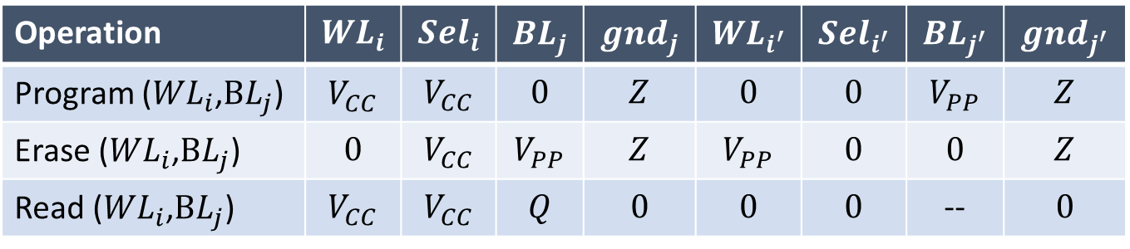
EEPROM (or E²PROM)
Just for the sake of completeness
It won’t be part of the exam!!
Architecture (real) – To solve the problems
How should be driven
Notes
${WL}_{i^{′}}$, ${Sel}_{i^{′}}$, ${BL}_{j^{′}}$, and ${gnd}_{j^{′}}$ indicate, respectively, all other $WL$, $Sel$, $BL$, and $gnd$ different from $WL_{i}$, $Sel_{i}$, $BL_{j}$ , and $gnd_{j}$
$Z$ = high impedance
Operation | $${WL}_{i}$$ | $${Sel}_{i}$$ | $${BL}_{j}$$ | $${gnd}_{j}$$ | $${WL}_{i^{′}}$$ | $${Sel}_{i^{′}}$$ | $${BL}_{j^{′}}$$ | $${gnd}_{j^{′}}$$
Program (${WL}_{i}$,$BL_{j}$) | $$V_{CC}$$ | $$V_{CC}$$ | $$0$$ | $$Z$$ | $$0$$ | $$0$$ | $$V_{PP}$$ | $$Z$$
Erase (${WL}_{i}$,$BL_{j}$) | $$0$$ | $$V_{CC}$$ | $$V_{PP}$$ | $$Z$$ | $$V_{PP}$$ | $$0$$ | $$0$$ | $$Z$$
Read (${WL}_{i}$,$BL_{j}$) | $$V_{CC}$$ | $$V_{CC}$$ | $$Q$$ | $$0$$ | $$0$$ | $$0$$ | -- | $$0$$

